Slide 1
Identification of different structures in a .pdb file
Daniel Bedmar Romero - 1565494
Nanoscience and Nanotechnology 22/23

Slide 2
Justification of the report
This report is in a power point format because my intention is that it can be followed the process that led me to the identification of the structures. Therefore in this powerpoint we will see this process and at the end the conclusions

Slide 3
The process

Slide 4
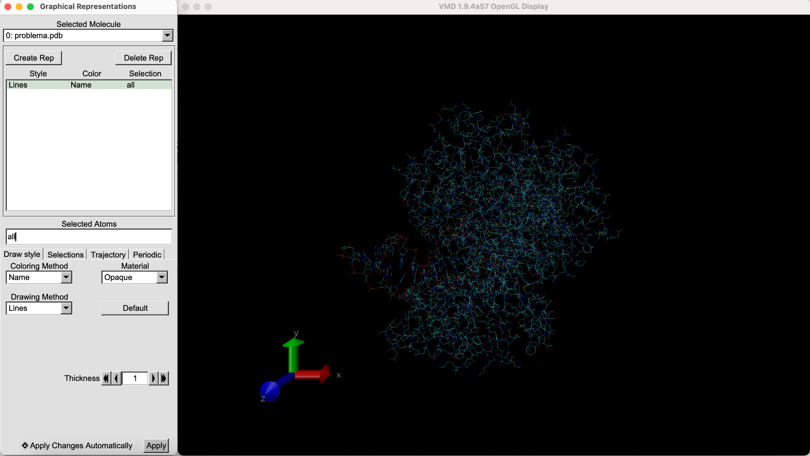
Problema pdb file. This is the problema file opened with VMD

Slide 5
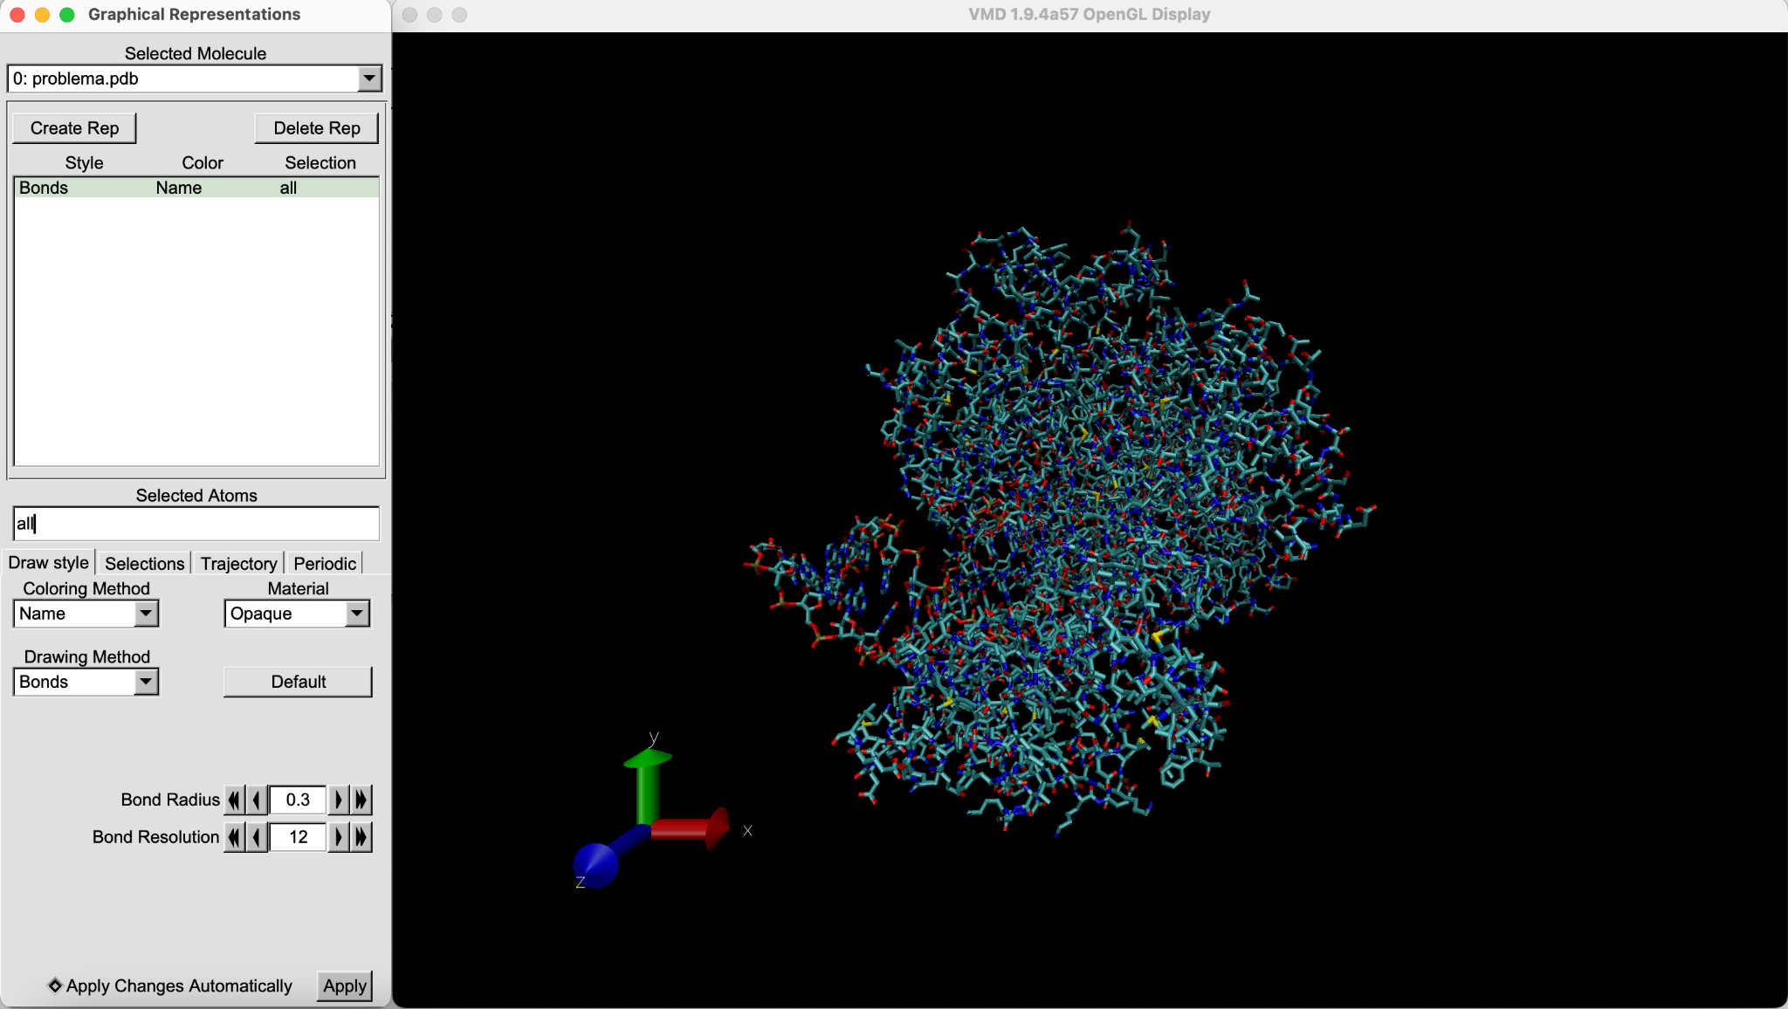
First of all I changed the drawing mode to Bonds so it is more friendly

Slide 6
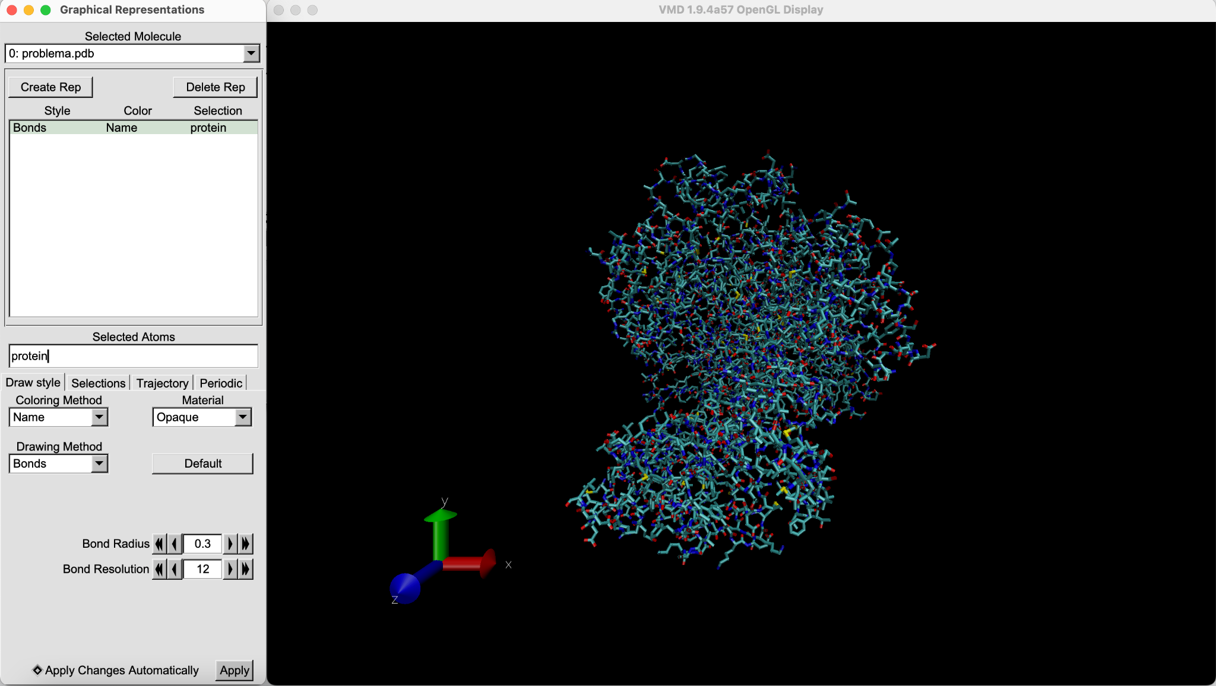
Then I tried to see if there is any protein. Turns out is the most part of it

Slide 7
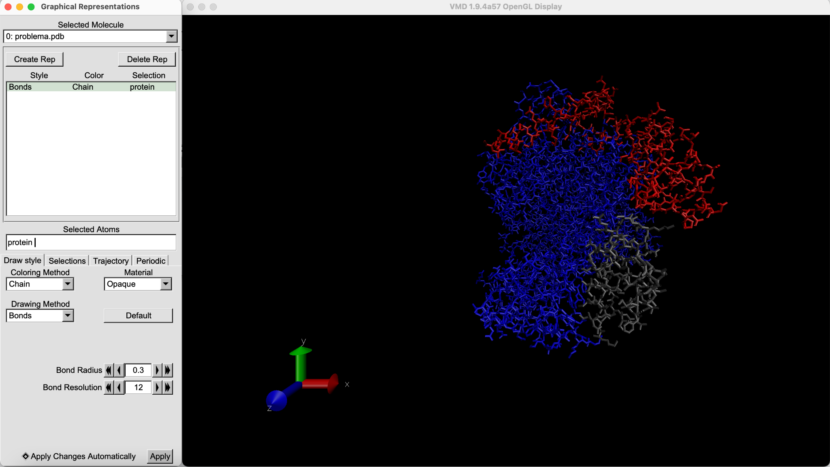
Then I changed the coloring method to chain in order to see if there are different chains

Slide 8
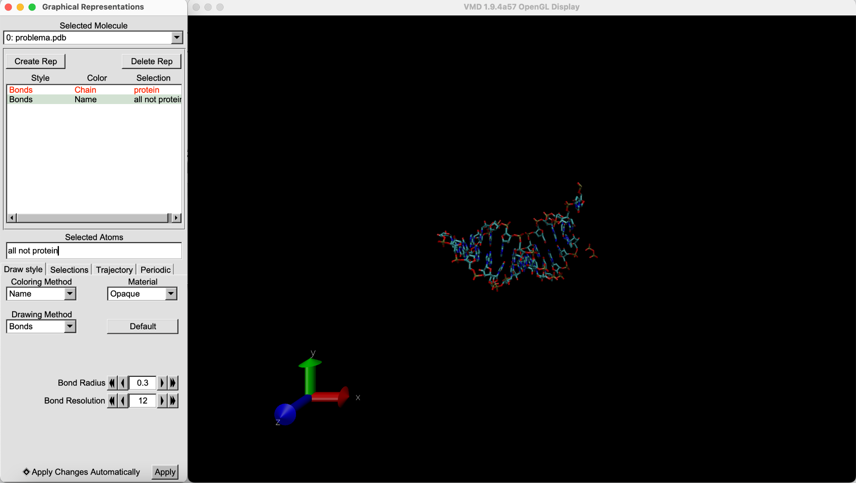
Then I visualized the rest of the structure by selecting “all not protein”.
It looks like DNA or RNA strands

Slide 9
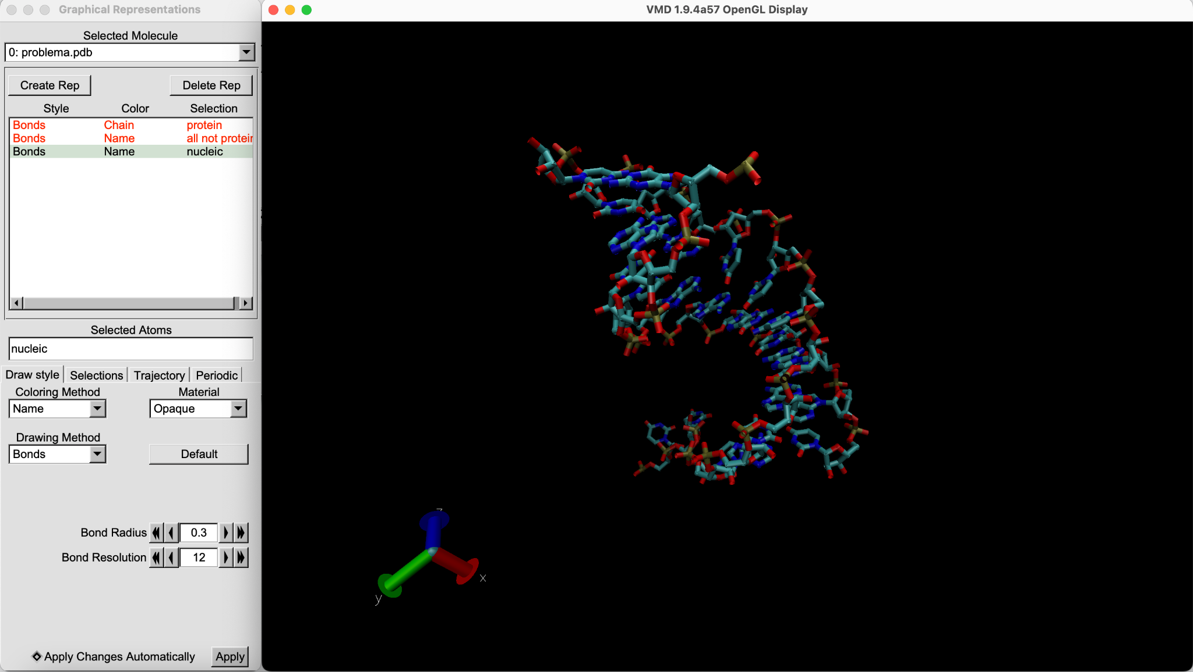
Because I thought it was DNA or ARN i tried to select the “nucleic”
But by doing this I lost some molecules

Slide 10
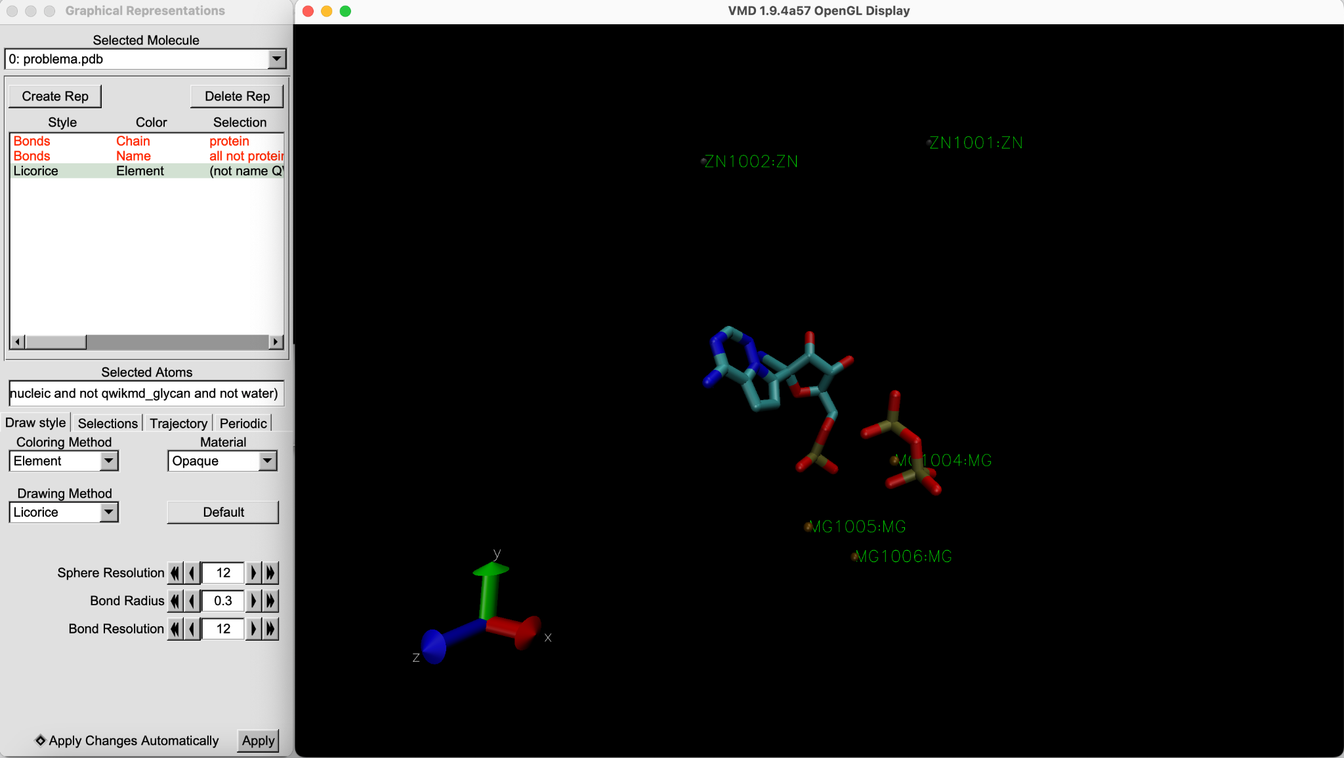
Therefore I went trought the different selection options and found one called “qwikmd_hetero” and I found that a part from the nucleotide and the proteins there are 5 atoms and 2 molecules

Slide 11
Deduction of the different molecules

Slide 12
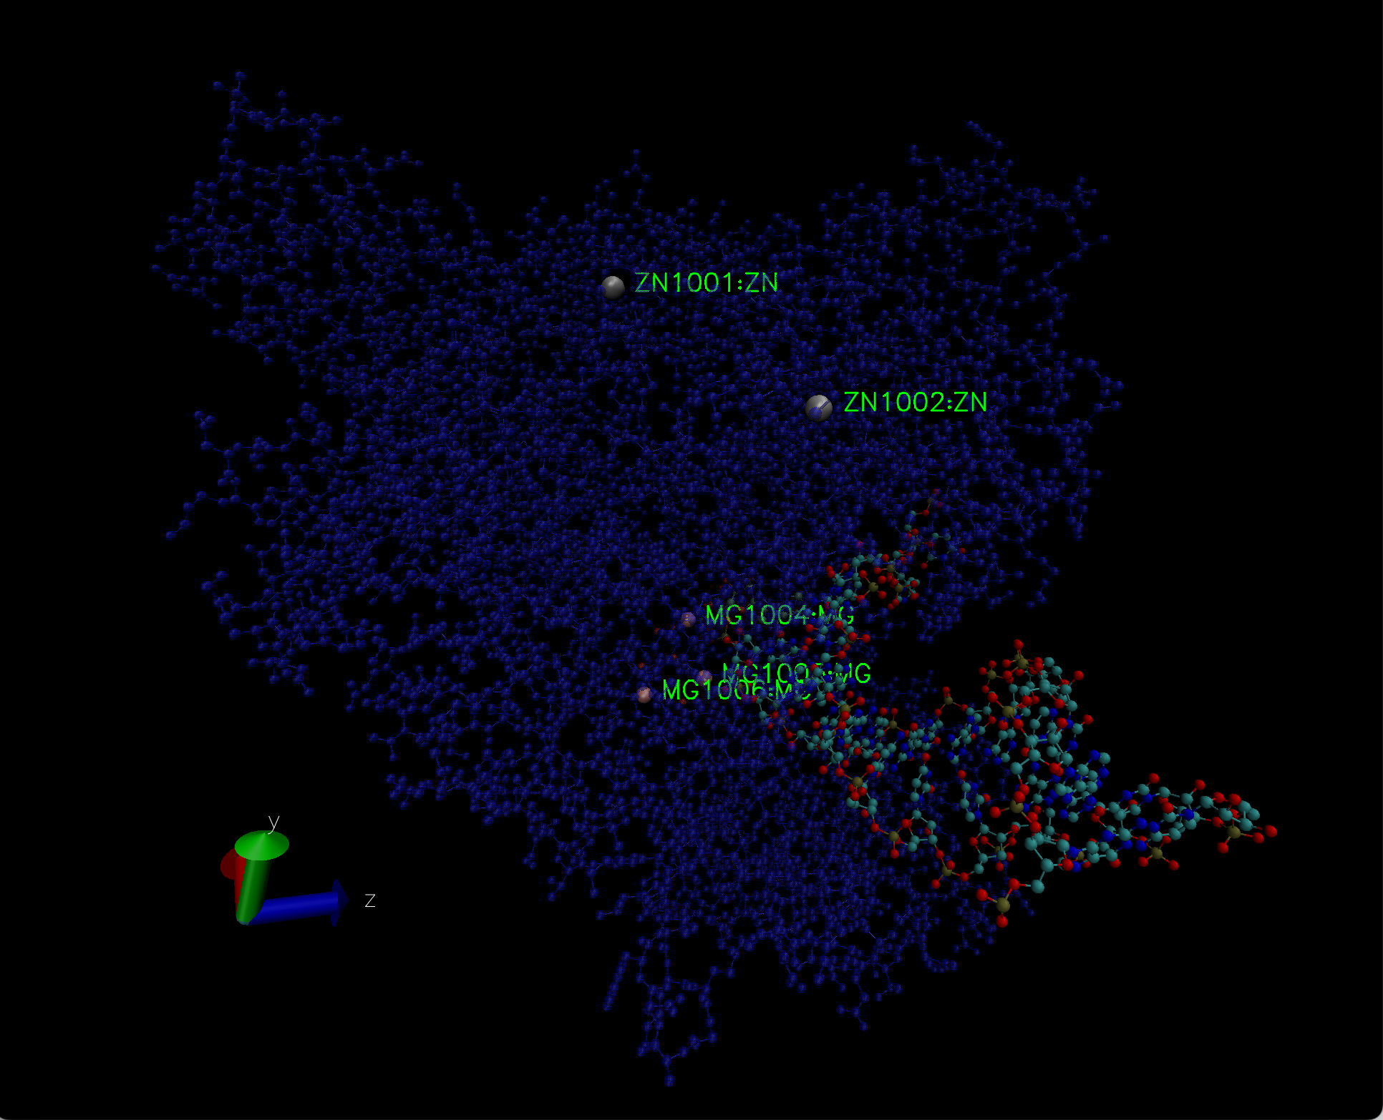
1. The spare atoms: In order to see the atoms I visualized the main chain of the protein and the nucleotide strands and highlighted and labeled the atoms by representing the VDW with a bigger sphere
Based on the location of the atoms in the protein I concluded that the Zinc atoms serve an structural purpose so the chain folds correctly but the Magnesium atoms probably also play a fundamental role in the functionality of the protein.
This atoms are called cofactors.
pdb file of the cofactors

Slide 13
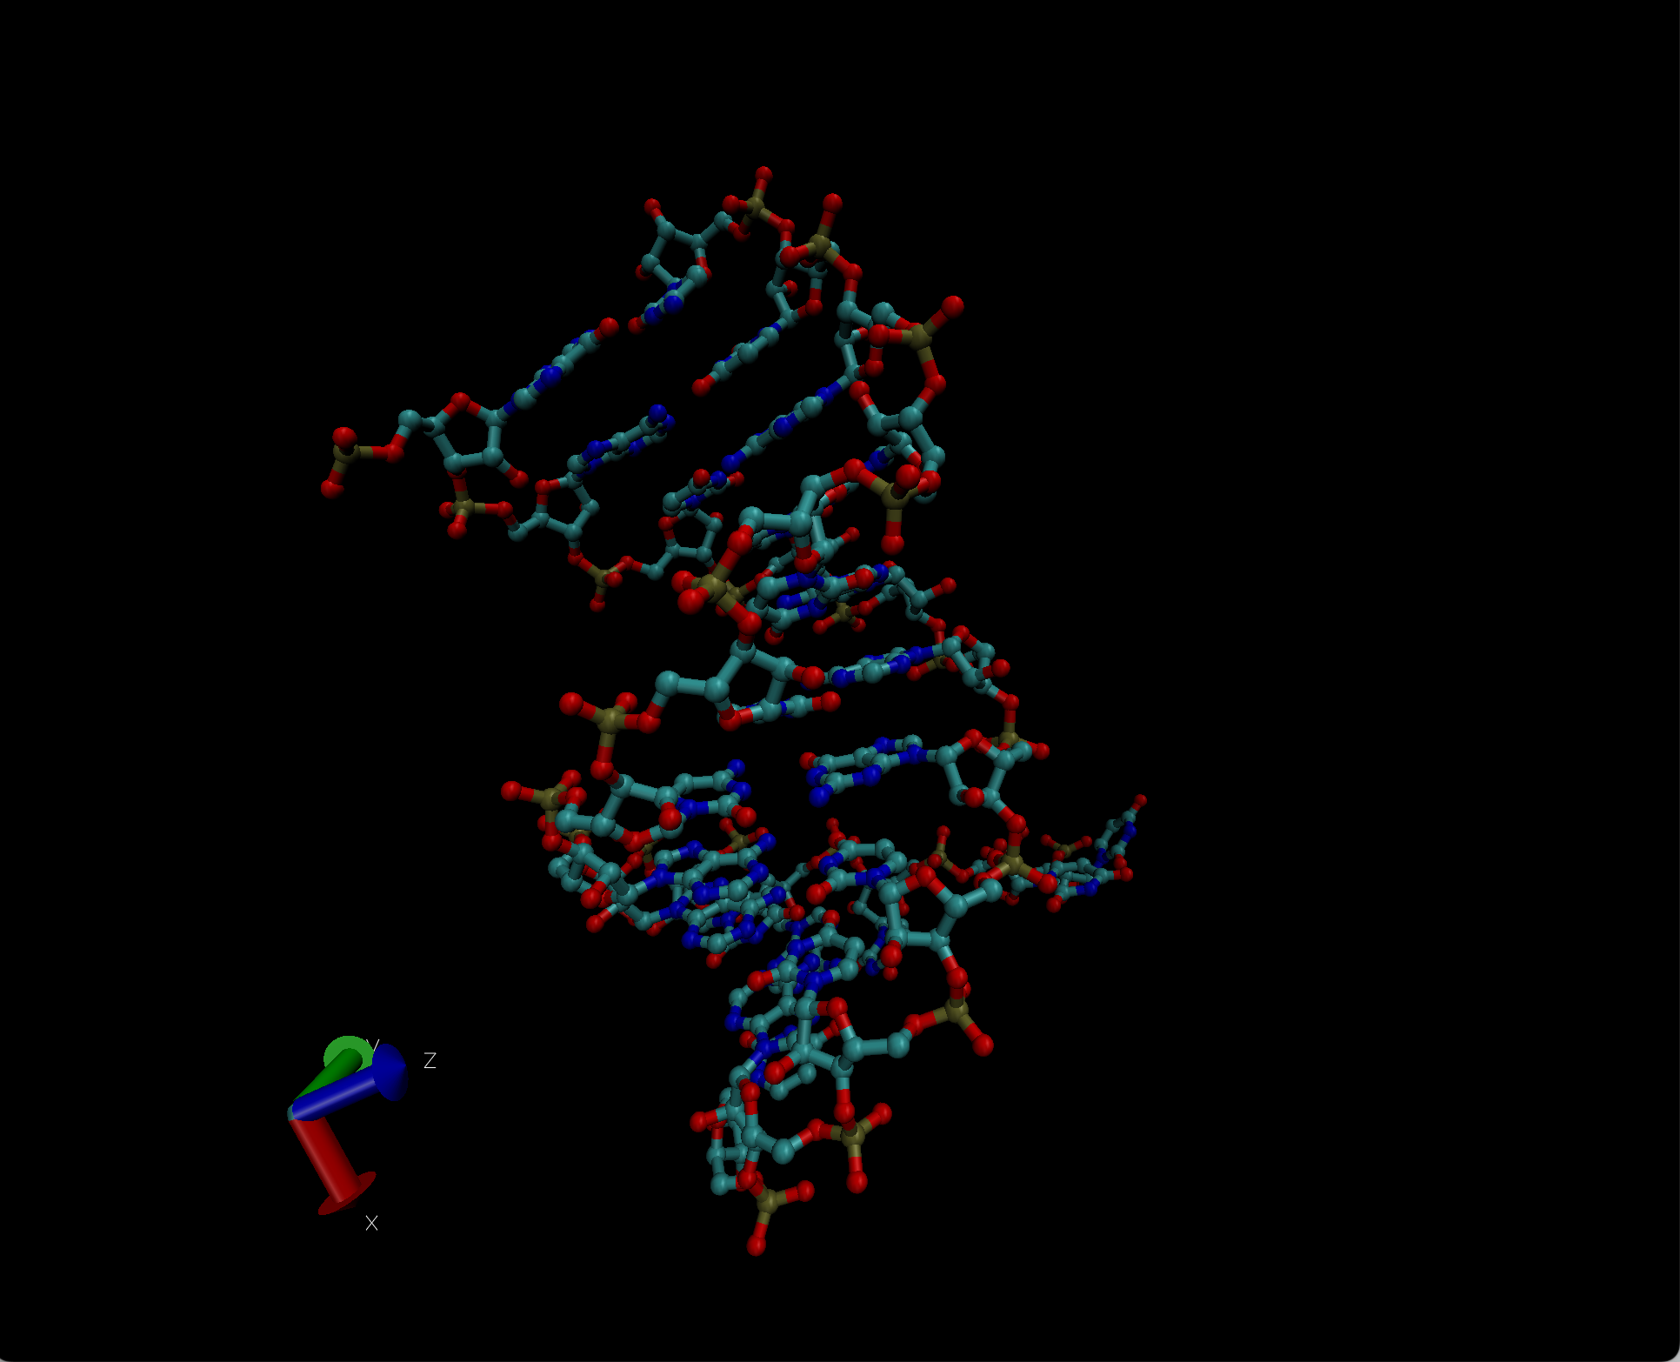
2. The nucleotide strands: In this case the interesting thing to see is if these are RNA or DNA strands.
In order to deduce between DNA or RNA I came up with two strategies.
pdb file of the strands

Slide 14
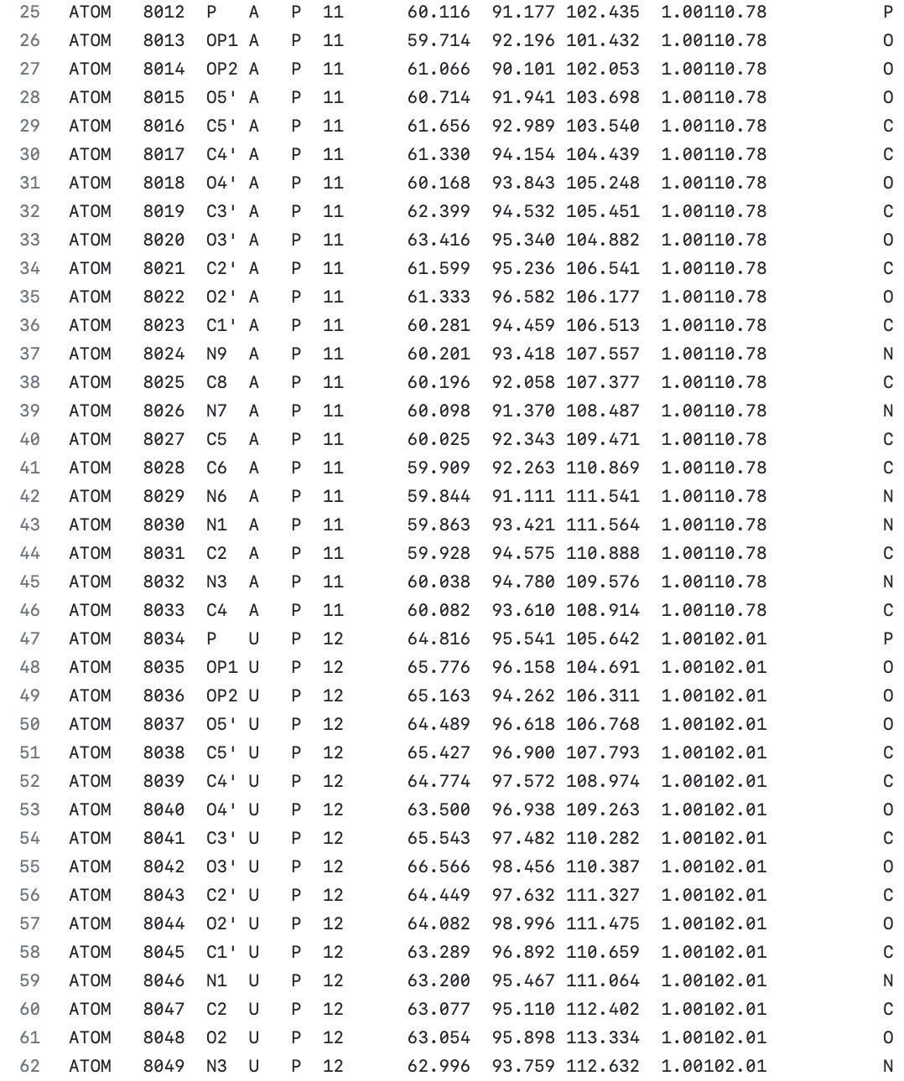
2. The nucleotide strands: In this case the interesting thing to see is if these are RNA or DNA strands.
The first strategy thing I did was to look at the pdb file to see if there were some Uracile nucleotides or not. I found out that it seems like there are Uracile residues in both strands.
pdb file of the strands

Slide 15
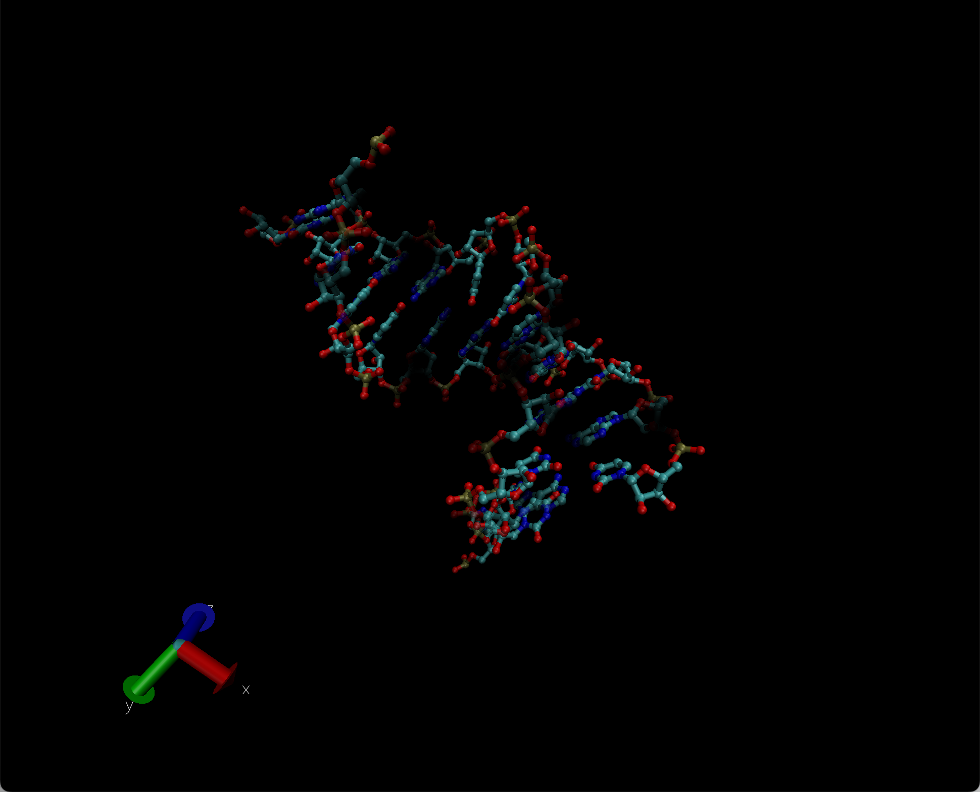
2. The nucleotide strands: In this case the interesting thing to see is if these are RNA or DNA strands.
To confirm that the Uracile were in both strands, I created a new pdb file only with the Uracile residues and overlap its representation with the representation of the strands but in transparent “material”.
As it can be seen in the figure besides, there are Uracile residues in both strands, therefore, these are two RNA strands
pdb file of the strands

Slide 16
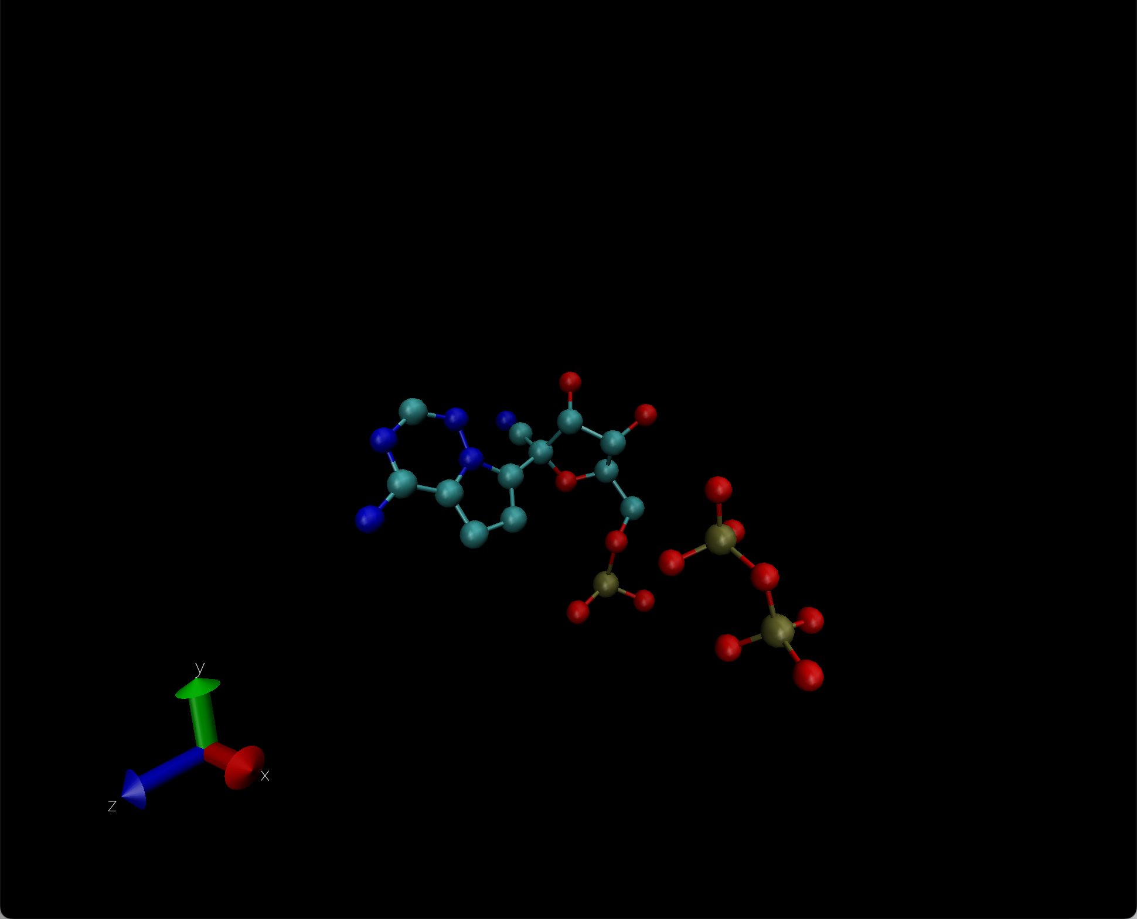
3. The spare molecules: I wanted to identify both molecules

Slide 17
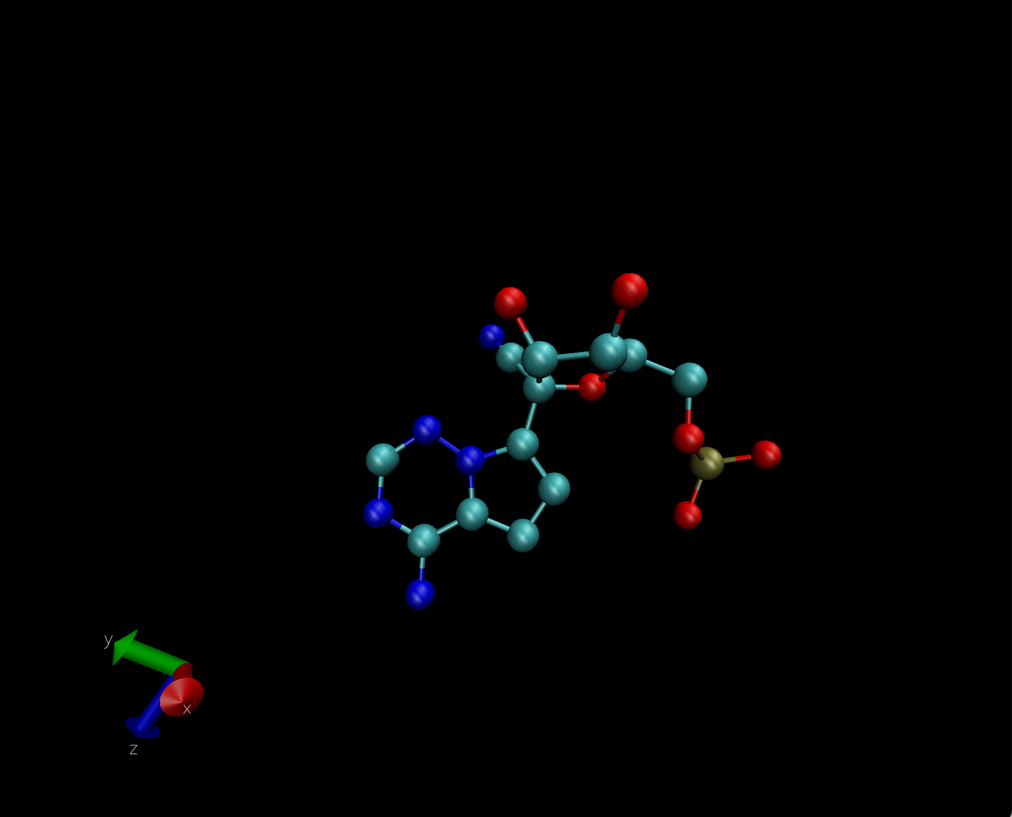
3. The spare molecules: I wanted to identify both molecules
The first molecule
The first molecule I identified was the big one. I identified it as an Adenine precursor/Adenine rest. In order to do so I compared it with the rest of the nucleotides because it was similar to them and as it was in the active site of the protein it made sense to me that it had to be related with the nucleotides.
pdb file of the Adenine precursor/rest

Slide 18
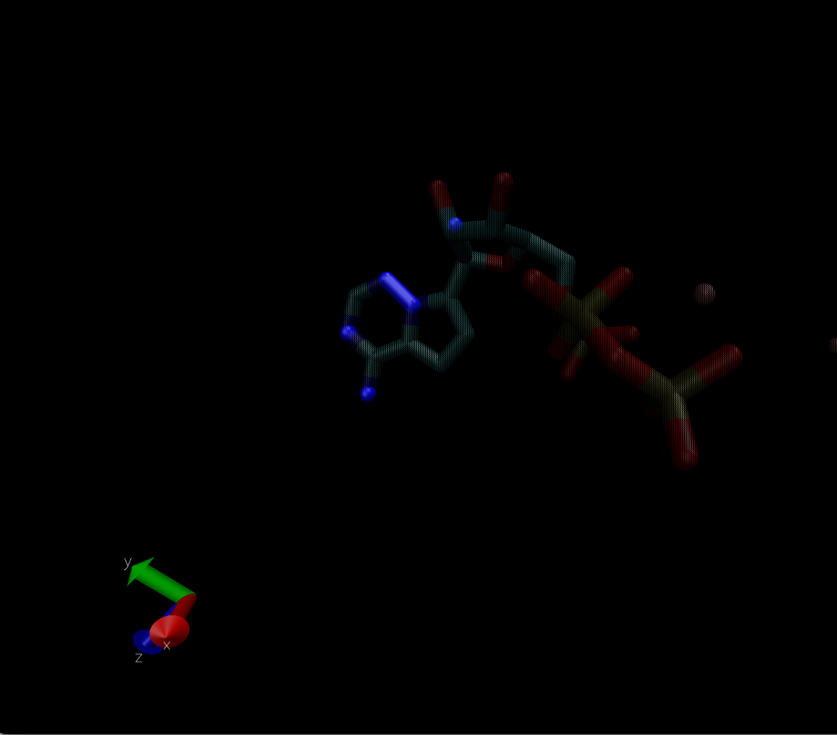
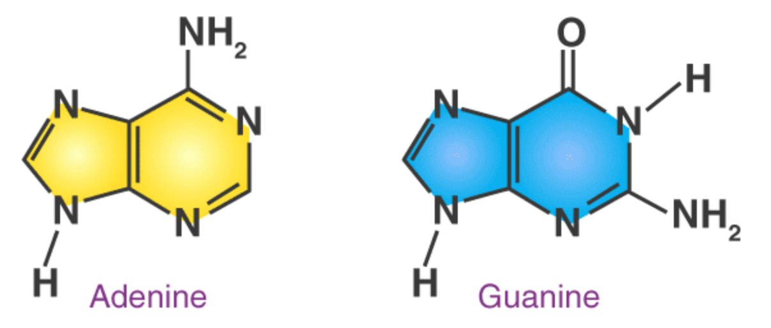
3. The spare molecules: I wanted to identify both molecules
The first molecule
I identified it as an Adenine related molecule because from the double ringed nucleotides is the only one that only has a functional group in the external group and it’s a NH2 gropu
pdb file of the Adenine precursor/rest

Slide 19
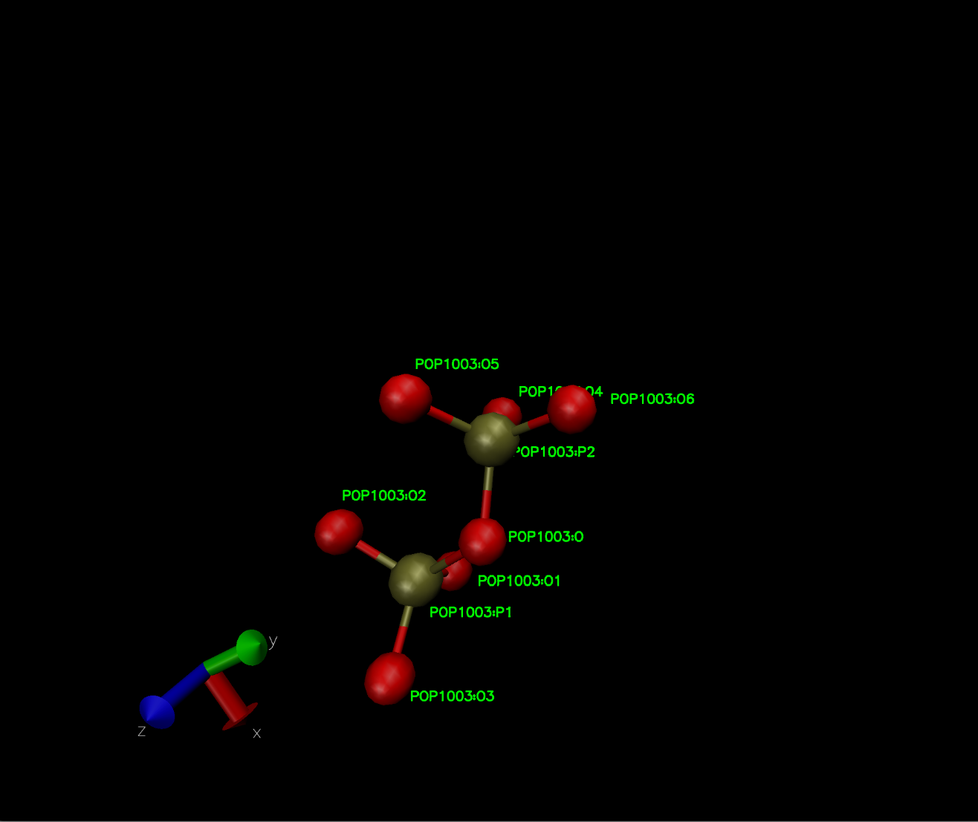
3. The spare molecules: I wanted to identify both molecules
The second molecule
I identified the second molecule as two Phosphate bonded together by identifying the atoms that formed the molecule
pdb file of the 2 Phosphate group

Slide 20
4. The protein. In this case I did not intended to identify the exact protein but to make a valid guess of which type of protein was and what was its biological role
pdb file of the protein

Slide 21
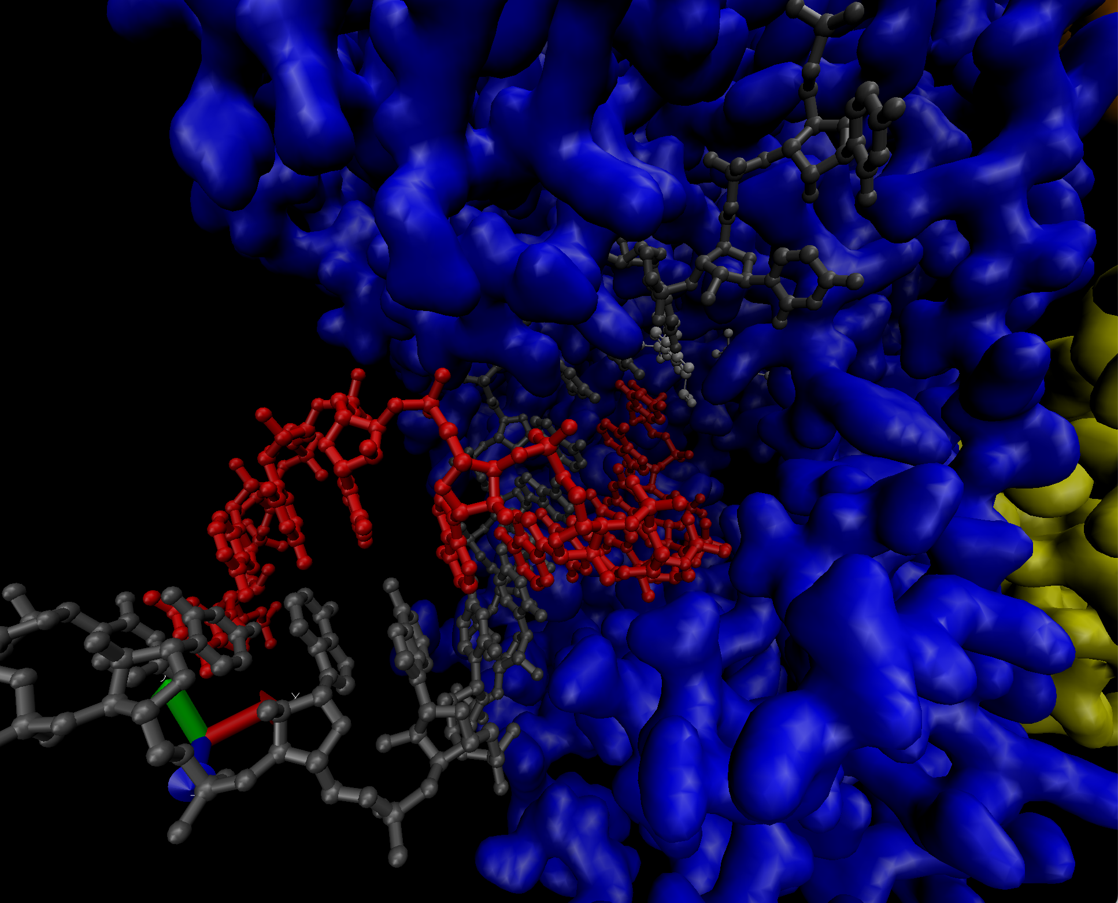
4. The protein. In this case I did not intended to identify the exact protein but to make a valid guess of which type of protein was and what was its biological role
In order to make a guess about this protein I had different things I have deduced during this whole exercice:
· The protein cleary has an active site where a double strand of RNA is located
· Only one of the strands is inside the active site and the other one seems to be separating from the strand located in the protein
· Near the active site there is and Adenine precursor (or the rests of an Adenine) and two bonded phosphate groups
· It seems to be a hole from where molecules enter/exit the protein in the opposite side from which the protein enters
pdb file of the protein

Slide 22
Conclusion

Slide 23
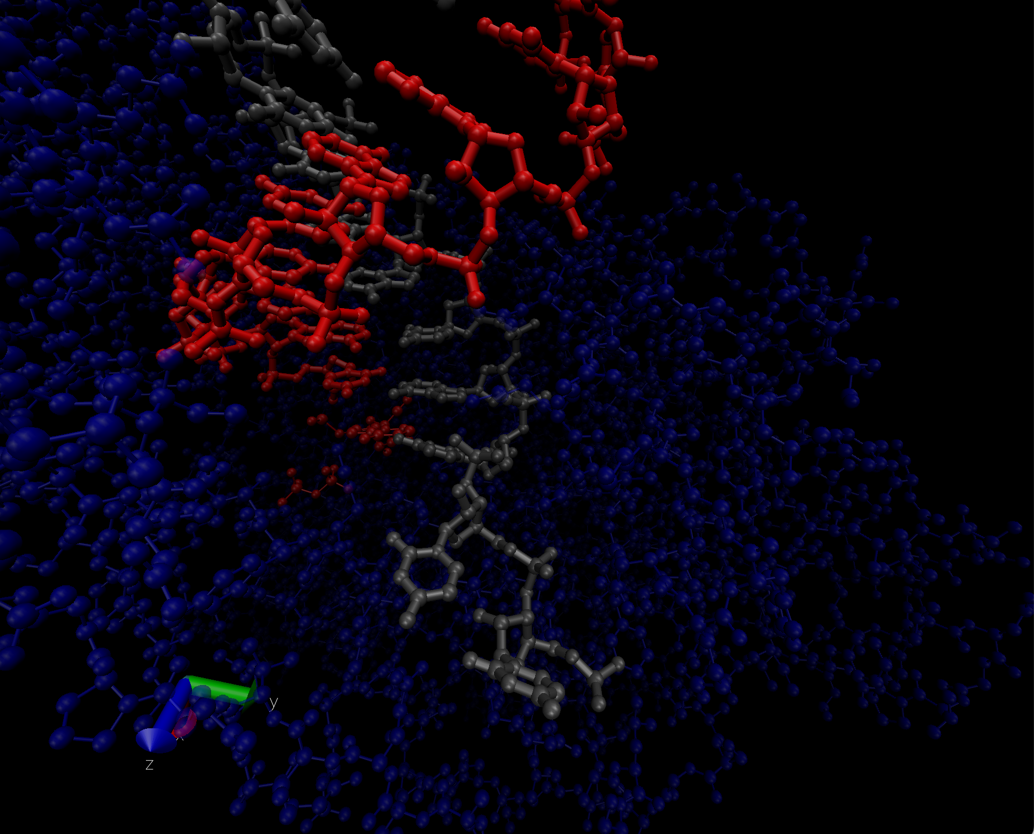
Conclusion
I have deducted that this protein could be copying an ARN strand, because the 2 bonded phosphate could be the rest of an ATP and it is being used to use the energy of cleaving the Phosphate groups to add one of them to link the nucleotides and the nucleotides could be entering to the active site by the hole in the main chain (maybe if there are not enough Zn this hole could remain closed and the protein turned off). In this case, the model strand would be the gray one.
This protein could be found in virus or near a celular nuclei and it would be used in the transcription of genetic material.
Github repository

